Slide 1
Word Similarity Finder
Toma Sabin-Sebastian

Slide 2
What does my app do?
My application is designed to process input words, find their valid representations in a pre-trained Word2Vec model and suggest similar words based on semantic similarity.
Word2Vec is a popular technique in Natural Language Processing (NLP) for converting words into numerical representations called word embeddings.

Slide 3
Libraries
Gensim: is a robust library for topic modeling and natural language processing (NLP), widely used for handling vector space models like Word2Vec.
KeyedVectors loads pre-trained word embedding models, such as Word2Vec (e.g. Google News vectors)
NumPy is a library for numerical computations, offering powerful data structures like arrays and functions for mathematical operations.

Slide 4
Libraries
NLTK (Natural Language Toolkit) is a popular NLP library providing tools for tokenization, stemming, lemmatization, stopword removal and more.
SpellChecker is a A lightweight library for spelling correction in Python.
Levenshtein provides efficient functions for string distance metrics, such as Levenshtein distance (edit distance).

Slide 5
Word2Vec model
Model used: GoogleNews-vectors-negative300.bin
This is a pre-trained word embedding model based on Word2Vec, trained on data from the Google News corpus (approximately 100 billion words).

Slide 6
Dataset
The googlenews-vectors-negative300.bin file refers to pre-trained word embeddings from the Google News Word2Vec model. These embeddings, created using the Word2Vec algorithm, map words into a 300-dimensional vector space, where semantically similar words are located closer together.
There is no explicit dataset used apart from the Word2Vec model’s vocabulary.

Slide 7
Overview of the code
Input processing: Normalize: Convert input to lowercase and remove extra spaces. Spell check: Correct misspelled words using the SpellChecker library. Stop Word Removal: Filter out common, unimportant words (e.g., "the", "and").
Validation: Retain words that exist in the Word2Vec model's vocabulary.
Similarity Calculation: Compute the centroid of the valid words' embeddings. Retrieve the top 50 most similar words from the model based on the centroid.

Slide 8
Additional features and output
Lemmatization: Normalize input and similar words to their root forms using WordNetLemmatizer. Avoid selecting words with the same root as the input words.
Typo Filtering: Use Levenshtein similarity to discard words that are too similar (potential typos) to the input.
Output: Input Words: The processed and validated input words from the model's vocabulary. Similar Words: A list of semantically related words, with: their similarity scores and filtering to ensure relevance and avoid redundancy.

Slide 9
Backend
I used Flask, a lightweight Python web framework.
Request method: POST. Example: { "text": "king, woman“
Processing: The process_words function normalizes, corrects and validates the input words and calculates semantically similar words using Word2Vec.
Response:{“similar_words”: [
{“word”: “prince”, “similarity”: 0.653},
{“word”: “princess”, “similarity”: 0.611} ]
}

Slide 10
Frontend
A Flask based frontend that serves a simple web interface to interact with the backend API.
Request method: POST. Retrives the text input(input_text) from the submitted form. Sends a POST request to the backend API at URL, the request contains the input_text. If there aren’t any errors, which were handled and evertyhing responds succesfully, renders the results.

Slide 11
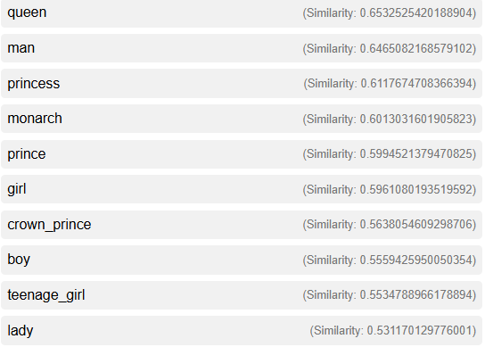
Results
Input_text: king, woman

Slide 12
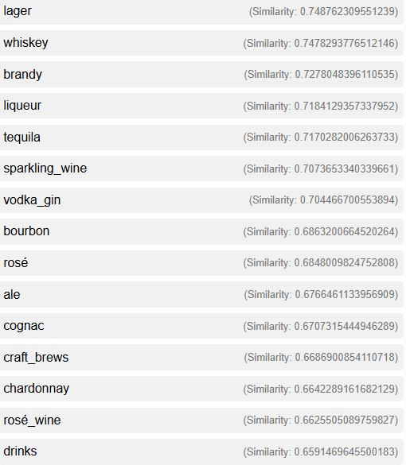
Results
Input_text:beer,wine,vodka

Slide 13
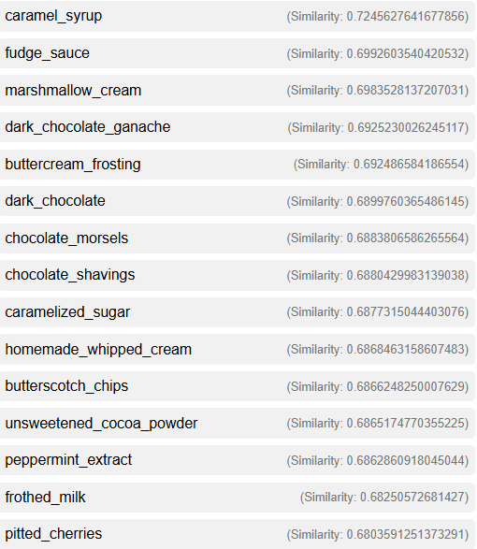
Results
Input_text:chocolate, ice, cream, caramel

Slide 14
Conclusion
I developed a web application that generates the lexical field of the words provided as input, using the technologies mentioned in the previous slides: Word2Vec, Flask, request methods (POST), and libraries such as NumPy, Gensim, NLTK, and SpellChecker.

